Slide 1
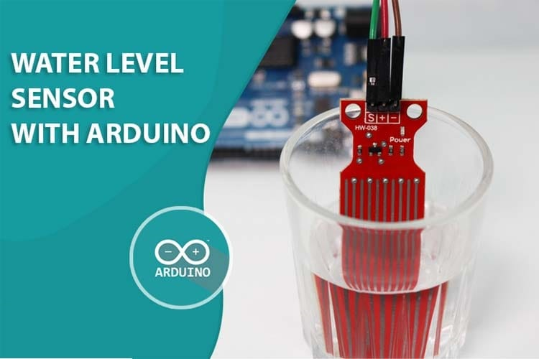
SMART BOTTLE

Slide 2

PROBLEM STATEMENT
Develop an IOT based system to monitor fluid and electrolyte levels in hospitals. The system alerts staff when levels are low, ensuring timely interventions for patient care and faster recovery.

Slide 3

OBJECTIVES
Remote Monitoring: Provides remote monitoring capabilities, allowing healthcare providers to receive alerts via SMS and take action from anywhere.
Reduced Risk: Minimizes the risk of errors associated with manual monitoring, enhancing patient safety and healthcare efficiency.
Cost-effectiveness: Offers a cost-effective solution for fluid level monitoring compared to more complex automated systems, making it accessible for healthcare facilities with limited resources.

Slide 4

RESOURCES
Material Resources :
Water level sensor
Microcontroller
Communication
module
Power supply
Human Resources:
Project Manager
Hardware and Software engineers
Healthcare professionals
for feedback

Slide 5

BUDGET
Here is a budget estimate for setting up a water level monitoring system using an Arduino:
1. Arduino :₹600 -₹700
2.Breadboard: ₹50 - ₹60
3.Water Level Sensor : ₹50 - ₹100
4.Led light : ₹5- ₹10
5.Jumpwires : ₹5- ₹10
6.Buzzer : ₹20-₹30
7.GSM Module : ₹300- ₹500
8.SIM Card : ₹50
9.Adapter : ₹140- ₹200
Total Estimated Cost : around ₹1000- ₹2000

Slide 6
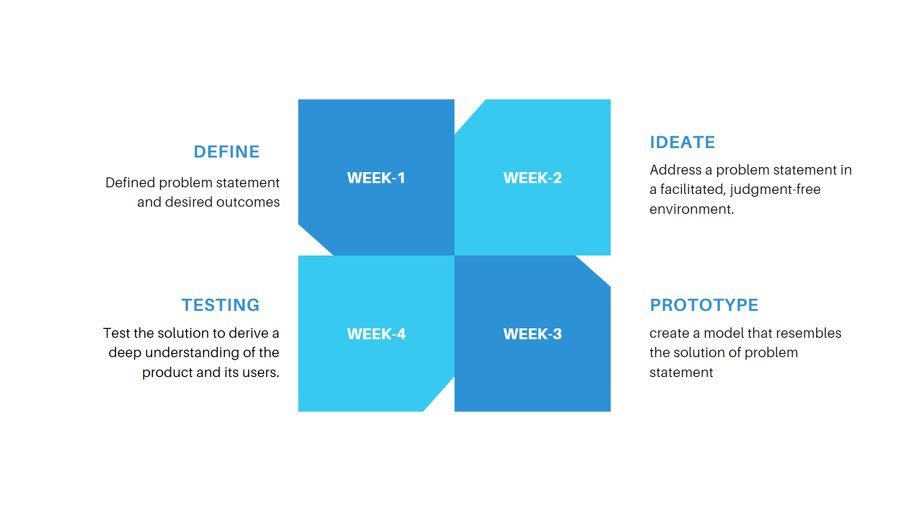
TIMELINE :

Slide 7
COMPONENTS

Slide 8
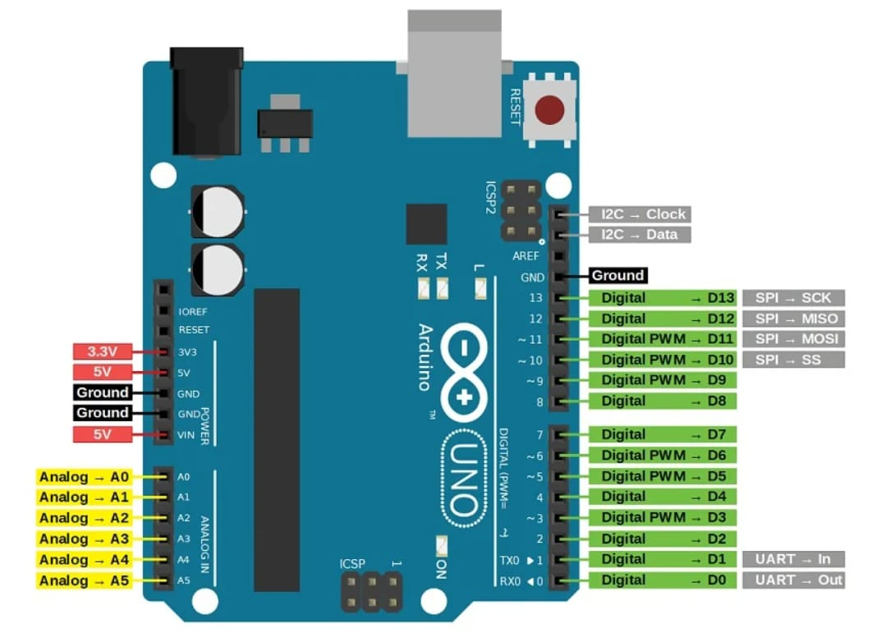
ARDUINO - UNO
Arduino is an open-source electronics platform based on easy-to-use hardware and software. Arduino boards are able to read inputs - light on a sensor, a finger on a button, or a Twitter message - and turn it into an output - activating a motor, turning on an LED, publishing something online.
Pin Description:
Vin: This is the input voltage pin of the Arduino board used to provide input supply from an external power source.
5V: This pin of the Arduino board is used as a regulated power supply voltage and it is used to give supply to the board as well as onboard components.
3.3V: This pin of the board is used to provide a supply of 3.3V which is generated from a voltage regulator on the board
GND: This pin of the board is used to ground the Arduino board.
Reset: This pin of the board is used to reset the microcontroller. It is used to Resets the microcontroller.
Analog Pins: The pins AO to A5 are used as an analog input and it is in the range of 0-5V.

Slide 9
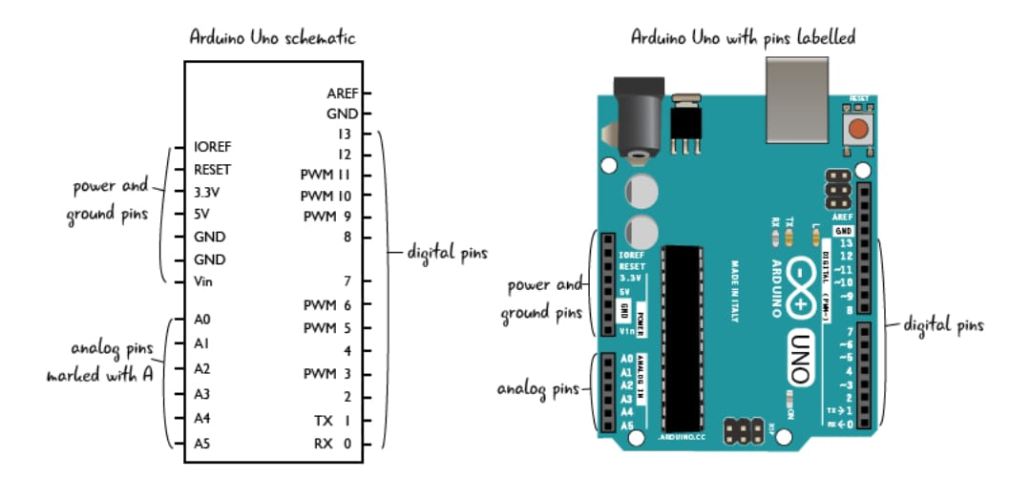
Digital Pins: The pins 0 to 13 are used as a digital input or output for the Arduino board.
Serial Pins: These pins are also known as a UART pin.It is used for communication between the Arduino board and a computer or other devices. The transmitter pin number 1 and receiver pin number 0 is used to transmit and receive the data resp.
External Interrupt Pins: This pin of the Arduino board is used to produce the External interrupt and it is done by pin numbers 2 and 3.
PWM Pins: This pins of the board is used to convert the digital signal into an analog by varying the width of the Pulse. The pin numbers 3,5,6,9,10 and 11 are used as a PWM pin.

Slide 10

Working:
Microcontroller: The Arduino Uno is powered by the ATmega328P microcontroller, which executes instructions from the uploaded program.
Input/Output Pins: It has 14 digital I/O pins and 6 analog input pins for interfacing with sensors, actuators, and other devices.
Programming: Programs (sketches) are written in the Arduino IDE, using a simplified version of C++, and uploaded to the board via USB.
Operation: The microcontroller reads inputs, processes data according to the program, and controls outputs, enabling interaction with various electronic components.

Slide 11
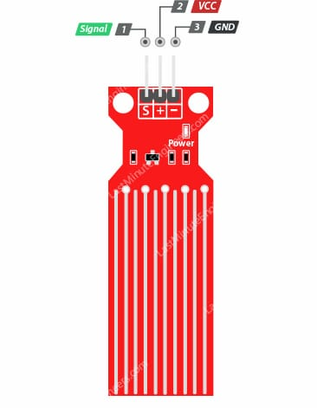
WATER LEVEL SENSOR
Water Level Sensor Pinout:
The water level sensor is extremely simple to use and only requires three pins to connect.
S (signal):It is an analog output pin that will be connected to one of your Arduino’s analog inputs.
+(Vcc) pin: It provides power to the sensor. It is recommended that the sensor be powered from 3.3V to 5V. Please keep in mind that the analog output will vary depending on the voltage supplied to the sensor.
– (GND) : It is the ground pin.

Slide 12
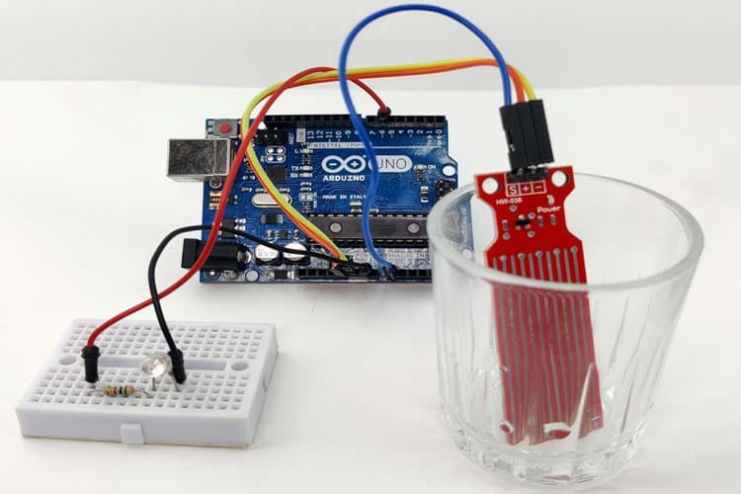
Working of water level sensor :
Detection Mechanism: Uses probes, electrodes, ultrasonic waves, or pressure sensors to detect water levels.
Circuit Completion: Water completes an electrical circuit when it touches the probes or electrodes.
Measurement: The sensor measures the water level based on which probes are in contact with water or via reflected ultrasonic waves or pressure changes.
Output: Provides data on water height for monitoring and control purposes.

Slide 13
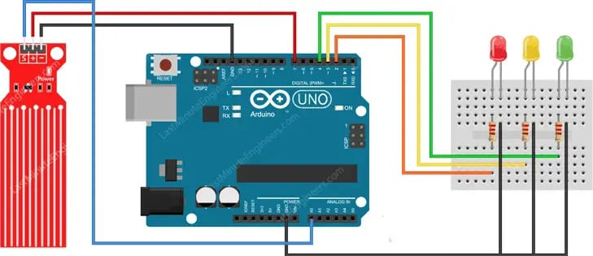
Wiring a Water Level Sensor to an Arduino:
To begin, connect the + (VCC) pin on the module to 5V on the Arduino and the – (GND) pin to ground.
One well-known issue with these sensors is that they have a shorter lifespan because they are constantly exposed to moisture. Moreover, constantly applying power to the sensor while immersed in water significantly accelerates the rate of corrosion.
To do this is to connect the sensor’s power pin to a digital pin on an Arduino and set it to HIGH or LOW as needed. So, we’ll connect the + (VCC) pin to the Arduino’s digital pin #7.
Finally, connect the S (Signal) pin to the Arduino’s A0 ADC pin.

Slide 14
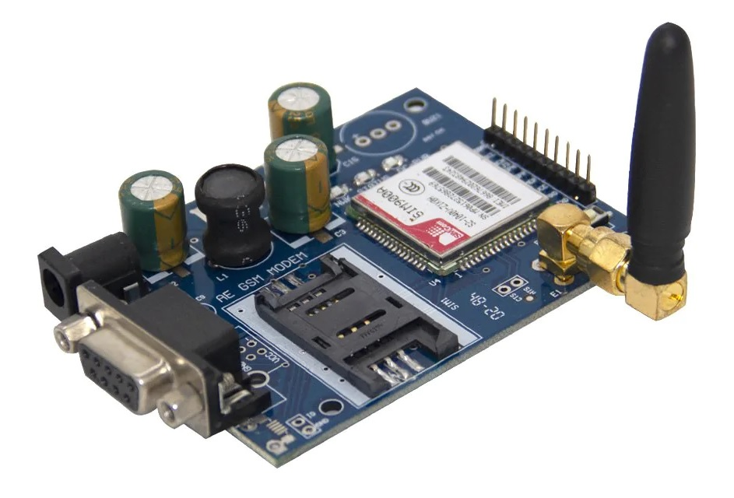
GSM MODULE :
GSM Communication: The GSM 900 module allows devices to communicate over the GSM network, enabling functionalities like voice calls, SMS, and data transmission.
Frequency Band:It operates primarily in the 900 MHz frequency band, which is commonly used for mobile communication in many parts of the world.
AT Commands:The module is controlled using AT commands, which are simple text-based instructions sent from a microcontroller or computer.
Versatile Applications: It is widely used in various applications including remote monitoring, SMS-based alert systems, and wireless data transfer.
Power and Antenna: The module typically requires a stable power supply and an external antenna to ensure reliable network connectivity and performance.

Slide 15
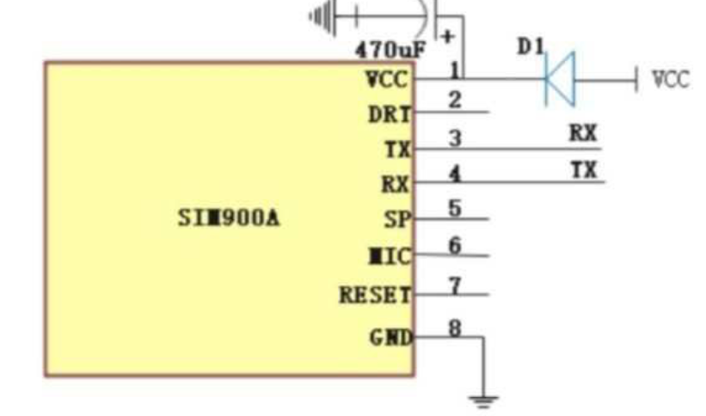
Working of GSM Module :
Initialization : Powering up and configuring the module.
SIM Detection : Checking for and initializing the SIM card.
Network Registration : Connecting to the cellular network.
Data Activation : Establishing data connectivity (if required).
Idle Mode : Waiting for commands from the microcontroller.
AT Command Handling : Responding to commands from the microcontroller.
Data Transmission/Reception : Sending or receiving data over the network.
Error Handling : Monitoring for errors and network issues.

Slide 16
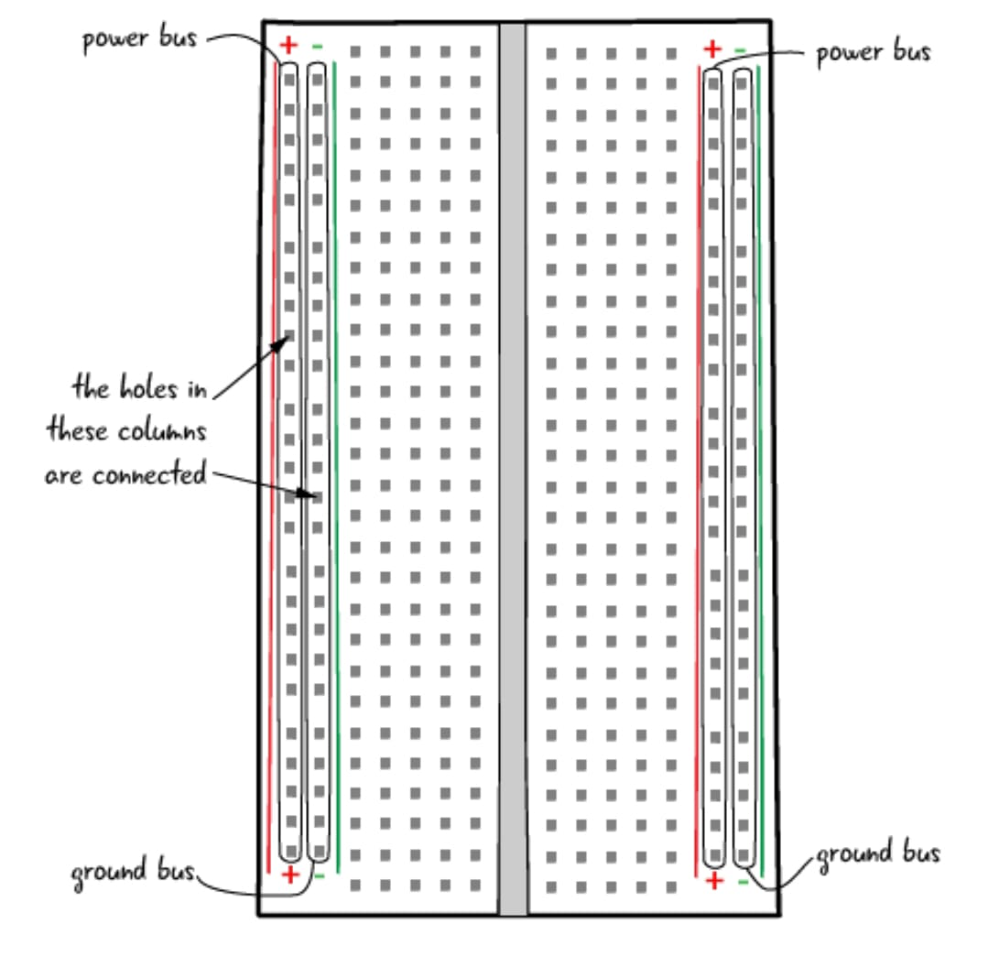
BREADBOARD
A breadboard is a handy tool used in electronics for building and testing circuits without the need for soldering.
It's like a temporary platform where you can plug in electronic components and wires to quickly prototype your ideas.
With rows and columns of interconnected metal strips beneath the surface, it provides a convenient way to create circuits by simply inserting components and making connections using jumper wires.

Slide 17
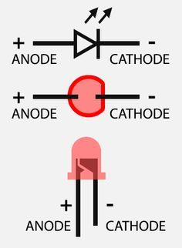
LEDs are semiconductor devices that emit light when an electric current passes through them in the forward direction, converting electrical energy into light energy. 1. Energy Efficiency: LEDs are highly efficient light sources, converting a large portion of electrical energy into visible light, resulting in reduced energy consumption and lower electricity bills. 2. Long Lifespan: With lifespans ranging from tens of thousands to hundreds of thousands of hours, LEDs offer long-lasting illumination, reducing the need for frequent replacement and maintenance.
LED(Light-Emitting Diode):

Slide 18
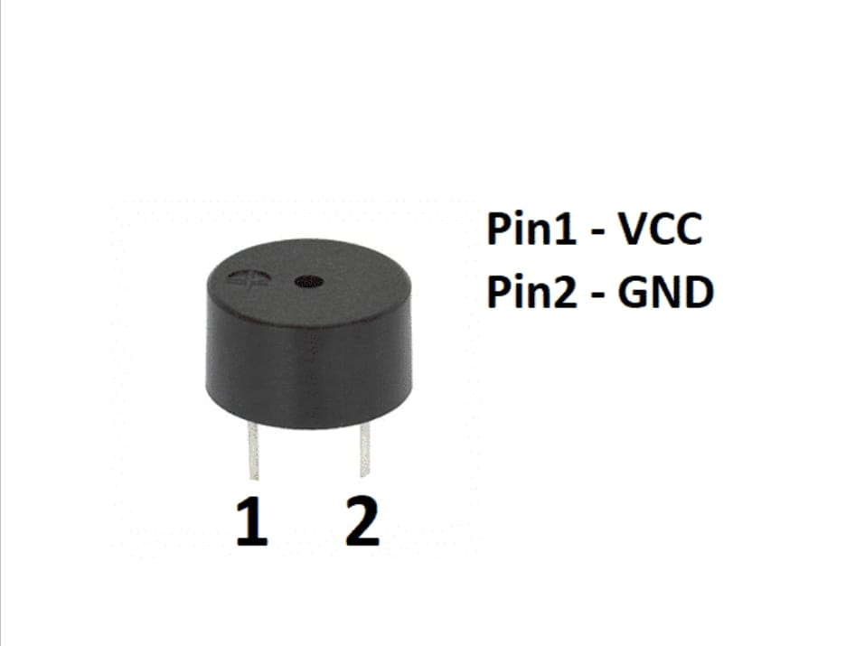
BUZZER:
A buzzer is an electronic sound-producing device that generates audible tones or alerts when an electric current is passed through it, causing a metal or plastic diaphragm to vibrate and produce sound waves.
Pin Description:
Pin1: It is a VCC pin. It is used to connect 5V to the piezo buzzer.
Pin2: It is a GND pin. It is used to connect GND

Slide 19
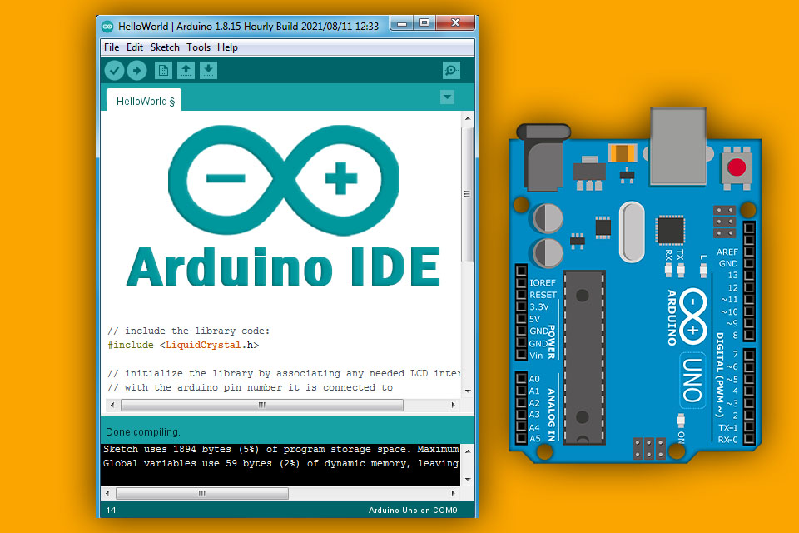
ARDUINO IDE
The Arduino Integrated Development Environment (IDE) is a software platform used for programming and developing applications for Arduino microcontroller boards.
It provides a user-friendly interface for writing, compiling, and uploading code to Arduino boards.
Installation and Usage:
Download : The Arduino IDE can be downloaded from the official Arduino and website.
Install : Follow the installation instructions specific to your operating system.
Setup : Once installed, you need to select your Arduino board and the appropriate COM port from “Tools” menu.
Coding : Start writing your sketches and use the provided tools to compile and upload them to your board.

Slide 20
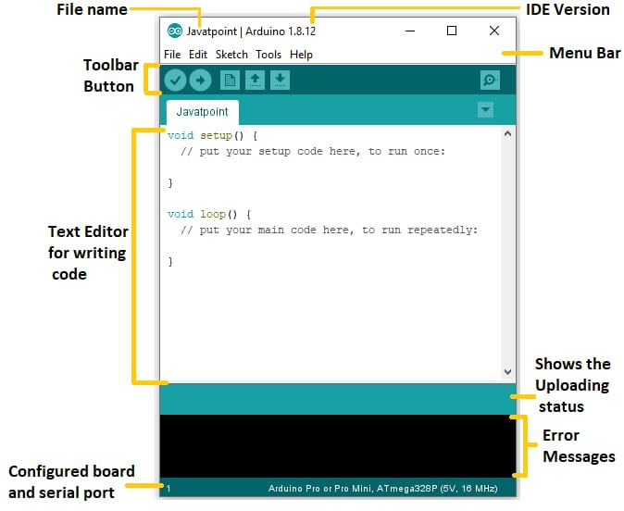
KEY FEATURES
Code Editor : The editor includes syntax highlighting, code folding, and auto-completion to enhance coding efficiency.
Library Manager : Easily add, manage, and update libraries for extended functionality.
Board Manager : Install and manage board definitions for official and third-party Arduino boards.
Integrated Serial Monitor : Communicate with and debug Arduino boards via serial communication.
Compiler and Uploader : Translate code into machine language and upload it to the Arduino board.
Example Sketches : Access numerous built-in examples to learn and experiment with different functions and libraries.
Cross-Platform : Available for Windows, macOS, and Linux, ensuring broad accessibility.

Slide 21
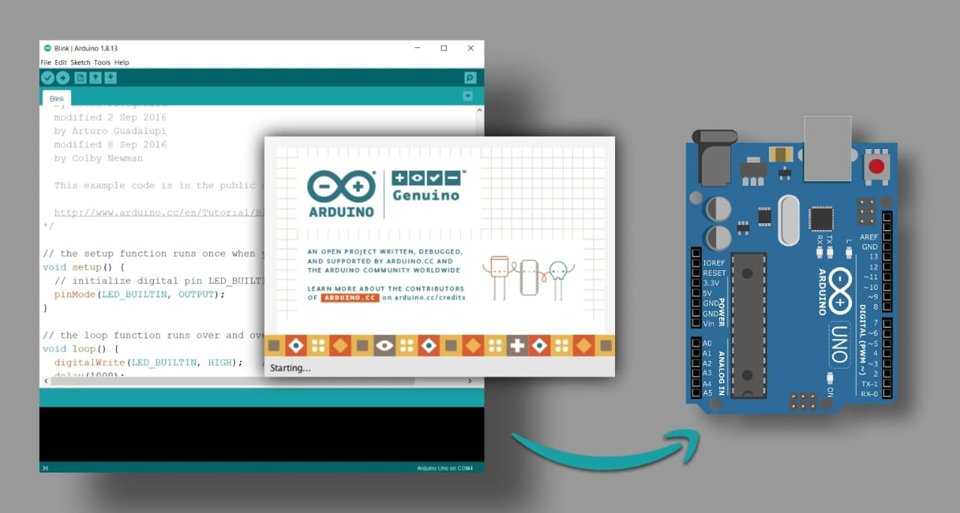
WORKFLOWWORKFLOW
Writing Code : Users write their code in the IDE using the Arduino programming language, which is based on C/C++.
Compiling : The code is compiled to check for errors and translate it into machine language.
Uploading : The compiled code is uploaded to the connected Arduino board.
Testing and Debugging : Users can test their sketches using the serial monitor and make adjustments as necessary.

Slide 22
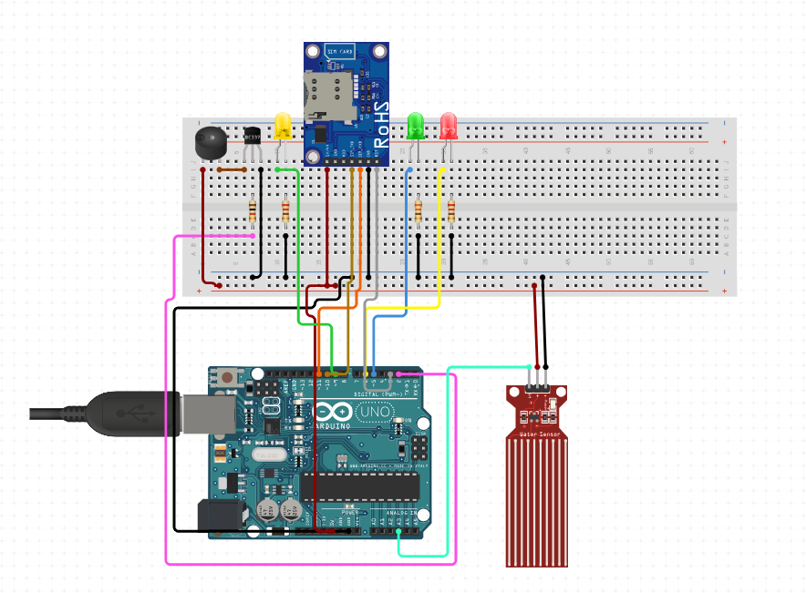
CIRCUIT

Slide 23
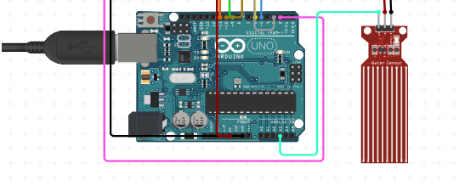
CIRCUIT DESCRIPTION
For most water sensors, you will need to connect three pins:
VCC (power),
GND (ground), and
OUT (output signal).
Here are some recommended pins for connecting a water sensor to an Arduino Uno:
VCC: Connect the VCC pin of the water sensor to the 3.3V or 5V pin on the Arduino Uno.
The choice between 3.3V and 5V will depend on the water sensor's voltage requirements.
GND: Connect the GND pin of the water sensor to one of the GND pins on the Arduino Uno.
OUT: Connect the OUT pin of the water sensor to a digital input pin on the Arduino Uno. You can choose any available digital input pin, such as pin 2, 3, 4, etc.

Slide 24
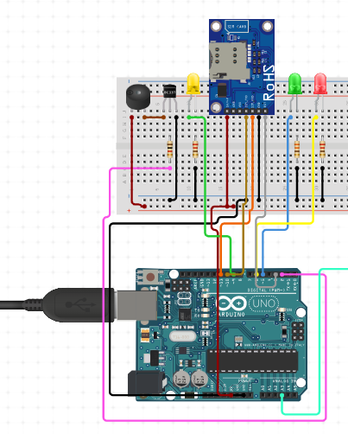
To connect a GSM module to an Arduino board, you will need to connect several pins, including VCC, GND, RX, and TX.
Here are some recommended pins for connecting a GSM module to an Arduino Uno:
VCC pin of the GSM module to the 5V pin on the Arduino Uno
GND pin of the GSM module to the GND pin on the Arduino Uno
RX pin of the GSM module to digital pin 0 on the Arduino Uno
TX pin of the GSM module to digital pin 1 on the Arduino Uno
How to connect a buzzer to a breadboard and an Arduino Uno:
Positive leg of the buzzer to digital pin 13 on the Arduino Uno.
Negative leg of the buzzer to a GND pin on the breadboard.

Slide 25
CODE DESCRIPTION

Slide 26
1.Library and Pin Definitions:
Description:
This section includes the necessary library (SoftwareSerial.h) for serial communication.
It declares global variables:
value: Used to store the analog reading from the sensor.
buzzerPin: Specifies the digital pin connected to the buzzer.
It initializes a SoftwareSerial object named gsmSerial with pins 7 (RX) and 8 (TX) for communication with the GSM module.
Code:
#include <SoftwareSerial.h>
SoftwareSerial mySerial(9, 10); // RX, TX
int value;
const int buzzerPin = 8;
// Buzzer connected to digital pin 8 (D8)
const char phoneNumber[] = "+919493818880";
// Phone number to call when water level is low

Slide 27
2.Setup Function:
Description:
This function initializes the serial communication for debugging and the software serial communication for the GSM module.
It sets the pin modes for the sensor, LEDs, and buzzer.
A delay is added to allow time for the GSM module to initialize.
It calls the sendSMS and call function to send an initialization SMS.
Code:
void setup() {
pinMode(A0, INPUT); // Sensor input
pinMode(13, OUTPUT); // Green LED
pinMode(12, OUTPUT); // Yellow LED
pinMode(11, OUTPUT); // Red LED
pinMode(buzzerPin, OUTPUT); // Buzzer
Serial.begin(9600); // Start serial communication for debugging
mySerial.begin(9600); // Start serial communication with GSM module
delay(1000);
initializeGSM();
}

Slide 28
3.Main Loop Function:
Description:
The loop function in Arduino programming is a fundamental part of the code that repeatedly executes a block of code for as long as the Arduino is powered on
It Reads the analog value from pin A0 using analogRead(A0) and stores it in the variable value.
Prints the sensor value to the serial monitor for debugging purposes with Serial.print and Serial.println.
Based on the sensor value, it evaluates three conditions and applies the corresponding actions for the selected condition.
Code:
void loop() {
value = analogRead(A0);
// Read the sensor value from analog pin A0
Serial.print("Sensor Value: ");
Serial.println(value);
// Print the sensor value to the serial monitor
// Determine which LED and buzzer state based on the sensor
value
if //condition 1
else if //condition 2
else //condition 3
delay(2000);
}

Slide 29
3.Main Loop Function:
Description(condition-1):
If the value read from the sensor is less than or equal to 300, it indicates a low saline level.
Turns on the green LED (pin 13) to indicate a low saline level.
Turns off the yellow (pin 12) and red (pin 11) LEDs.
Turns on the buzzer (pin 10) to provide an audible alert.
Sends an SMS alert
Make a call to the requested person
Code(condition-1):
if (value <= 300)
{
digitalWrite(13, LOW); // Turn off Green LED
digitalWrite(12, LOW); // Turn off Yellow LED
digitalWrite(11, HIGH); // Turn on Red LED
digitalWrite(buzzerPin, HIGH); // Turn on the buzzer
Serial.println("Red LED ON, Buzzer ON");
makeCall();
}

Slide 30
3.Main Loop Function:
Description(condition-2):
If the value is greater than 300 but less than or equal to 500, it indicates a moderate saline level.
Turns off the green (pin 13) and red (pin 11) LEDs.
Turns on the yellow LED (pin 12) to indicate a moderate saline level.
Turns off the buzzer (pin 10).
No call and No sms will be sent
Code(condition-2):
else if (value <= 500) {
digitalWrite(13, LOW); // Turn off Green LED
digitalWrite(12, HIGH); // Turn on Yellow LED
digitalWrite(11, LOW); // Turn off Red LED
digitalWrite(buzzerPin, LOW); // Turn off the buzzer
Serial.println("Yellow LED ON, Buzzer OFF");
}

Slide 31
3.Main Loop Function:
Description(condition-3):
If the value is greater than 500, it indicates a normal saline level.
Turns off the green (pin 13) and yellow (pin 12) LEDs.
Turns on the red LED (pin 11) to indicate a normal saline level.
Turns off the buzzer (pin 10).
No call and No sms will be sent
Code(condition-3):
else {
digitalWrite(13, HIGH); // Turn on Green LED
digitalWrite(12, LOW); // Turn off Yellow LED
digitalWrite(11, LOW); // Turn off Red LED
digitalWrite(buzzerPin, LOW); // Turn off the buzzer
Serial.println("Green LED ON, Buzzer OFF");
}

Slide 32
4.Call Sending Function:
Description:
It prints a message to the serial monitor indicating that a call is being made.
It sends a command to the GSM module to dial the specified phone number.
It waits for 10 seconds to allow the call to go through.
It sends a command to the GSM module to hang up the call.
It prints a message to the serial monitor indicating that the call has ended.
Code:
void makeCall() {
Serial.println("Making a call...");
mySerial.print("ATD");
mySerial.print(phoneNumber);
mySerial.println(";");
// Command to dial the specified phone number
delay(10000); // Wait for the call to go through
mySerial.println("ATH"); // Command to hang up the call
Serial.println("Call ended");
}

Slide 33
5.SMS Sending Function:
Description:
This Function checks whether the GSM module is Initialized or not
Later, this function sends an SMS using the GSM module.
It sets the SMS mode to text mode and specifies the recipient's phone number.
The message is then sent followed by the ASCII code for CTRL+Z to indicate the end of the message.
Delays are added to ensure proper communication with the GSM module.
Code:
void initializeGSM() {
Serial.println("Initializing GSM module...");
mySerial.println("AT"); // Check GSM module
delay(1000);
if (mySerial.available()) {
Serial.println("GSM module responded");
}else {
Serial.println("No response from GSM module");
}
mySerial.println("AT+CMGF=1"); // Set SMS text mode
delay(1000);
mySerial.println("AT+CNMI=1,2,0,0,0");
// Configure SMS settings
delay(1000);
Serial.println("GSM module initialized");
}

Slide 34

METHODOLOGY
The smart Bottle uses input sensors to continuously monitor these parameters in real time.
The system analyses the data and uses actuators to execute the appropriate actions

Slide 35

SOLUTION
A sensor that detects fluid levels and sends notifications to a user’s phone.
This application have a variety of applications across different fields.
.
Here are some examples:
Home Automation
Agriculture
Industrial Applications
Healthcare
Environmental Monitoring

Slide 36

EXECUTION
Sensor Creation :
Develop a fluid level sensor for water bodies.
Level Detection:
Configure the sensor to detect low water levels.
Notification :
Set up an alert system for designated personnel.
Actionable Alert :
Ensure alerts prompt necessary actions like refiling.

Slide 37
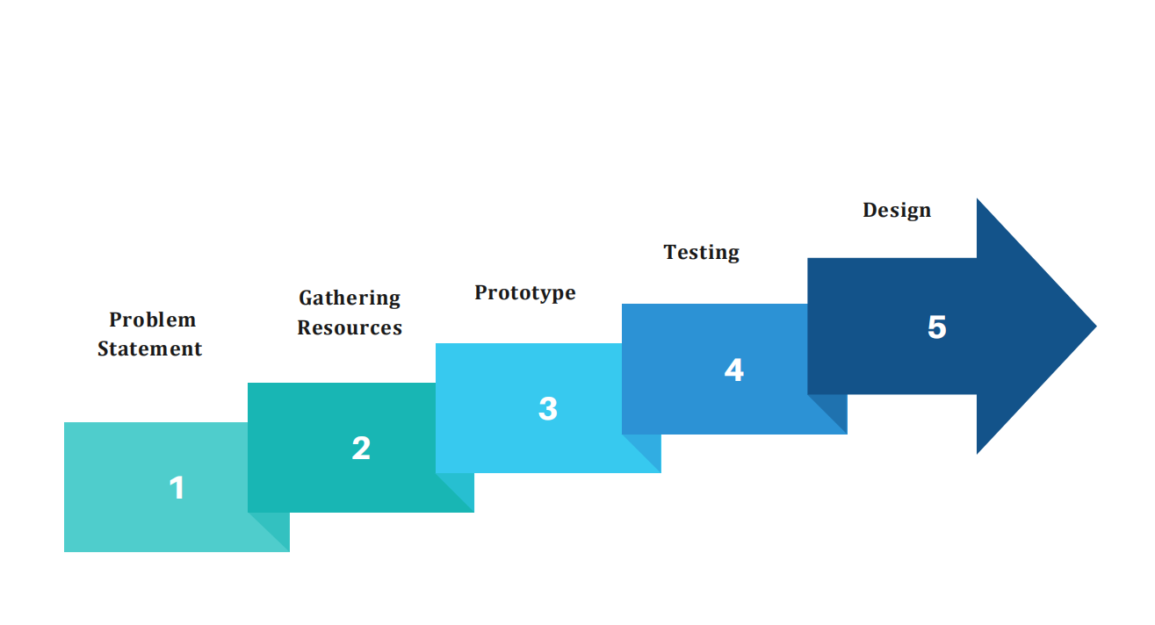
EXECUTION STAGES:

Slide 38
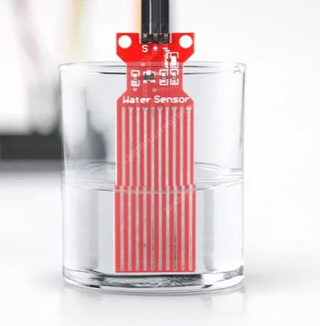
Conclusion:
This Arduino-based application monitors the fluid level of a saline drip using an analog sensor and provides visual, auditory, and SMS alerts.
When the fluid level is low, a red LED and buzzer are activated, and an SMS is sent to a predefined phone number, such as a nurse's.
The system ensures timely notifications to healthcare providers, preventing potential issues due to low saline levels.

Slide 39



TEAM MEMBERS:
B.JAYA NANDINI
III B.Tech IT
22B05A1201
Shri Vishnu Engineering College For Women
Y.LAKSHMI SOWMYA
II B.Tech AI&DS
22B01A45C6
Shri Vishnu Engineering College For Women
K.ANUSHA
II B.Tech ECE
22B01A0443
Shri Vishnu Engineering College For Women

Slide 40
Thank You!

